Slide 1
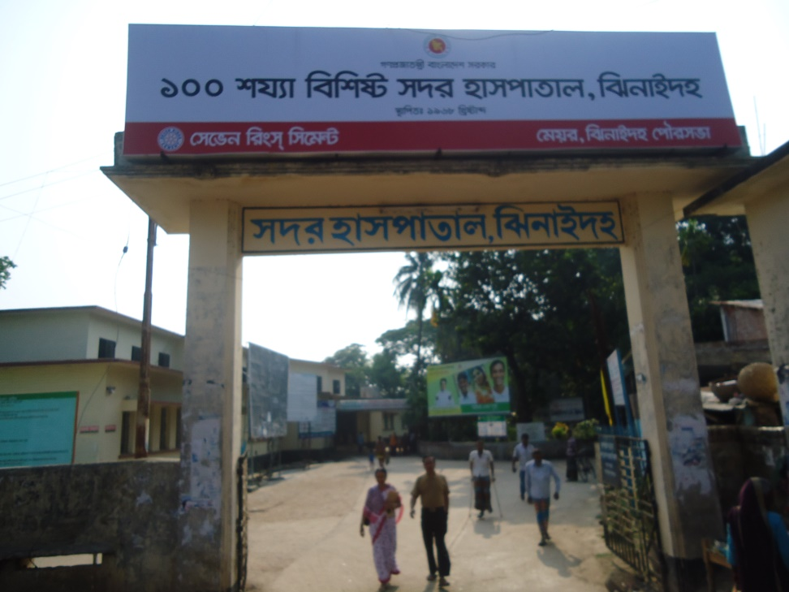

Community Support System in Chowgacha UHC & Jhenaidah Sadar Hospital
Dr. Md.Emdadul Haque
Senior Consultant (Obst & Gynae)
Sadar Hospital Jhenaidah

Slide 2

50 BEDED UPAZILA HEALTH COMPLEX
Chowgacha, Jessore.

Slide 3
Introduction
Community engagement is the basic element to run a health institution efficiently and effectively.
Initiation of community engagement started in the year of 1996 in Chowgacha and 2012 in Jhenaidah
Sensitization of the service providers and community leaders on the basis of identified problem.
Inviting community how they can engage in the hospital management process.
Discussion initiated with the community for identification of areas.

Slide 4

Upazila Health Complex
CHOWGACHA , JESSORE.
EOC Activities : 1997- 2011 (Hospital Delivery )

Slide 5

Upazila Health Complex
CHOWGACHA , JESSORE.
EOC Activities : 2000 - 2011 (Caesarian Section)

Slide 6






Slide 7


Community Participation in Jhenaidah Sadar Hospital
SADAR HOSPITAL, JHENAIDAH

Slide 8
Challenges before starting community participation !!
Limited human resources specially 4th class cleaner only (7).
No guard , gardener , ayah , ward boy , trolley man and electrician .
Inadequate all the services especially EOC and pediatric service.
Inadequate overall cleanliness.
Less coordination with local administration and community leaders .
Inadequate documentation and reporting System.
Insecure situation for the staff and hospital.
Hospital environment was not conducive .

Slide 9
Event of Community participant in Jhenaidah
Holding meeting with the service providers and hospital authority
Introduction of 5S KAIZEN in EOC ward
Baseline assessment
Dialogue with the local MP ,Mayor, local elites, Reporters and local administration
Forming “ Community Support group committee “ in Jhenaidah for improvement of district hospital.
Opening a bank account for the “ Community Support group “
Identification and sharing the type of support with the local community elite
Engagement of necessary support staff ( cleaners, Aya, ward boy, trolley man & security guards etc).
Holding monthly meeting with the local community support group.

Slide 10
Present support status !
54 manpower (Cleaner 19, Ayah & ward boy 20, Guard 7, Volunteer 5, Trolley man 3)
MP of Jhenaidah-2 himself providing support of 14 manpower .
Doctors of the hospital and Jhenaidah town supports 17 man power.
Mayor of Jhenaidah Paurasava plays an important role in cleanliness, repaired the boundary wall, supports 4 man power and renovation of pediatric word.
Retired secretary donated a generator for 24 hours OT service with a cost of nearly 33 thousand taka.
Chairman of Zahedee foundation supports 10 manpower and an intercom with a cost of nearly two lac taka.

Slide 11

Sadar Hospital, Jhenaidah
Bed Occupancy Rate from 1998 to 2015
Sl. No | Year | Bed Occupancy Rate
01 | 1998 | 126%
02 | 2011 | 146%
03 | 2013 | 165%
04 | 2015 | 193%

Slide 12
Emergency & Out Door, Indoor Service 1998 to 2015
Sadar Hospital, Jhenaidah

Slide 13
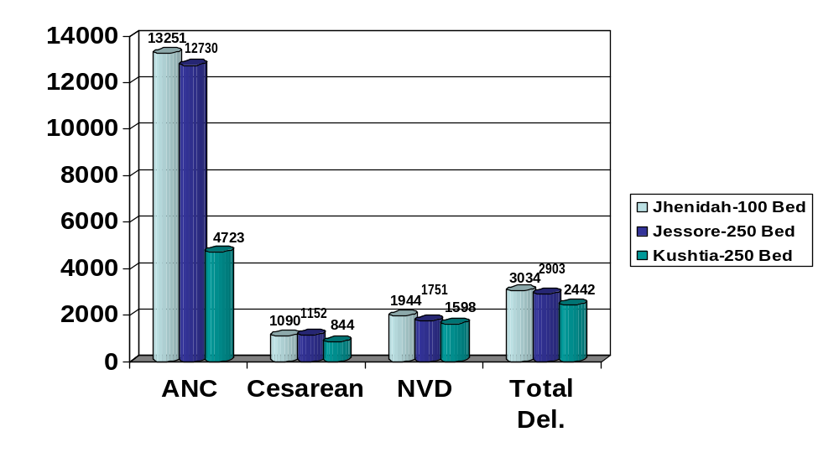
Comparative Data of EOC Service of 3 Best Performing District Hospital of Khulna Division in 2015

Slide 14
Operation Service (Major) 2011 to 2015
Sadar Hospital, Jhenaidah

Slide 15
Comparative data of revenue income in Jhenaidah Sadar Hospital from 2013-14 to 2015-16 F-year
Sadar Hospital, Jhenaidah

Slide 16


Introduction of TQM activities and Visit to Shatkhira District Hospital
  In 9 February, 2014, 5S-CQI -TQM program started by DGHS & SMPP JICA. Staff orientation on 5S-CQI-TQM process.
  5th August, 2014 an Idea sharing visit of 15 team members headed by civil surgeon at Shatkhira District Hospital with the help of JICA.

Slide 17


Display of citizens’ charter of Sadar Hospital.
Community supported guard is removing cycle, van and easy bike from the campus.

Slide 18


Cycle Stand
To secure the cycle and motor cycle of the patients and their attendants.
Safe drinking water supply for the patients and their attendants.

Slide 19


Hospital reception and information center for the patient and their attendance are developed by the community support system.
Display of the duty roaster of outdoor doctors.

Slide 20


Community supported trolley man is carrying a patient.
Community supported cleaner is cleaning the hospital.

Slide 21


To facilitate easier communication among the hospital staff an intercom is donated by an honorable local industrialist and thus the efficiency of the service has been improved
A non-operating government generator is activated and a new generator is supplied by the community to ensure electric facility.

Slide 22


Creation of awareness by Health Education for the patients and their attendances.
Motivation of the community, the teachers, reporters, social workers, cultural activists and donors of the hospital .

Slide 23


Antenatal and postnatal care of pregnant mother in antenatal corner of EOC word.
Breast feeding and family planning corner of EOC word.

Slide 24


Improved EOC (Emergency Obstetric Care) word service.
Improved pediatric word.

Slide 25


Girls’ Guide are working in the outdoor for lining of the patients to take proper service.
College going poor students are working in the hospital as nursing assistant (Volunteer).

Slide 26


Deputy Commissioner (DC), Jhenaidah visited the Sadar Hospital to observe the Hospital activities.
Superintendent of Police (SP), Jhenaidah visited the Sadar Hospital to observe the Hospital activities and to ensure security of the hospital.

Slide 27


MANOBOTA- a volunteer blood donor organization has formed by the doctors and SACMOs to donate blood for the thalasemic and other patient of the hospital.
A blood donation camp arranged by District Judge of Jhenaidah with the help of MANOBOTA.

Slide 28


Hospital campus beautification started by previous MP of Jhenaidah-2.
Beautification plant is planted by Zilla Praised Administrator and Upazilla Praised Chairman.

Slide 29


Hospital garbage is removed regularly by the Paurasava.
17th,March “a big cleaning day” is being celebrated to clean the hospital by DC, Mayor, Civil Surgeon & staffs of the hospital , under the leadership of Superintendent.

Slide 30
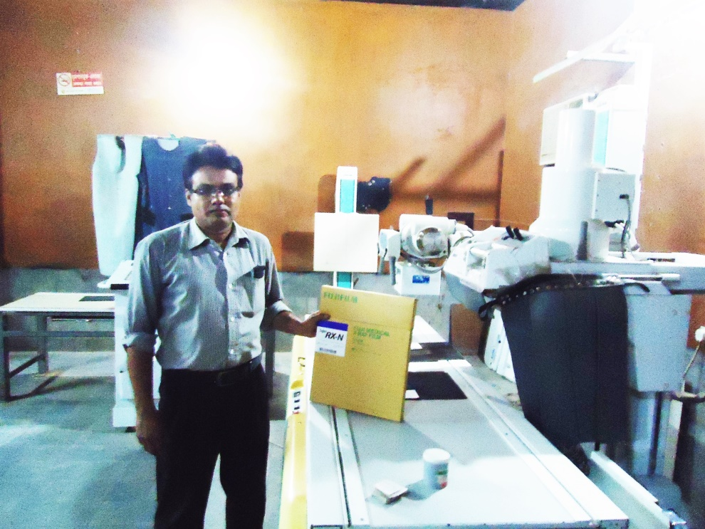
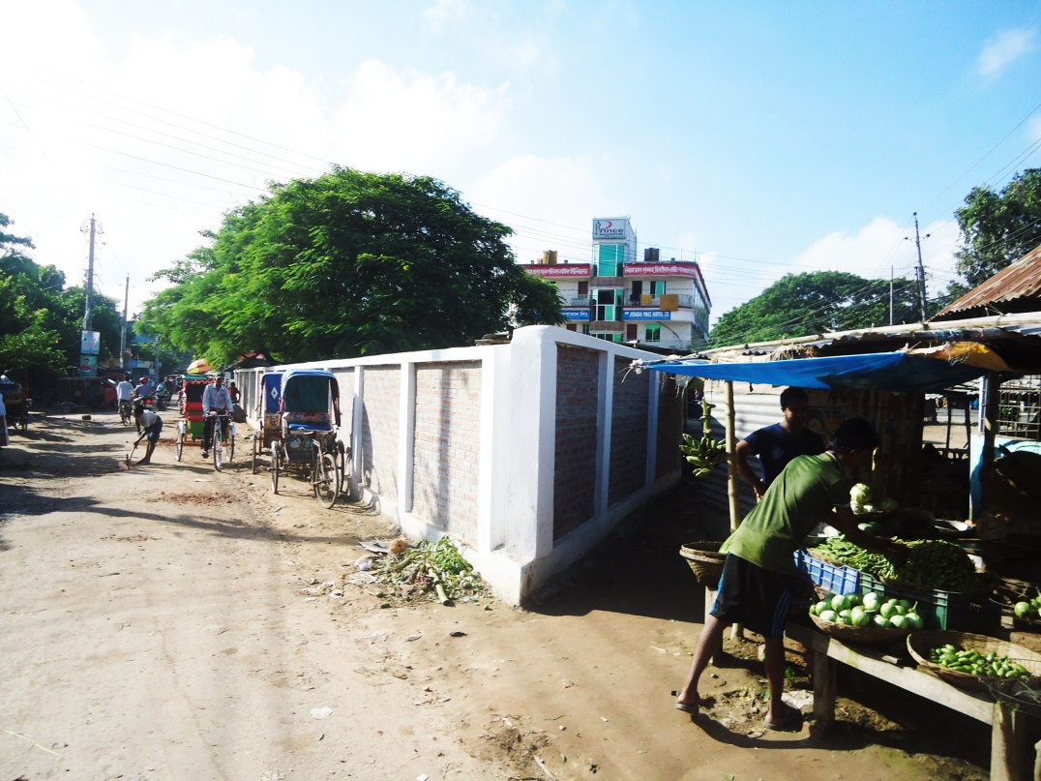
X-Ray Service system continued by the support of community in absence of supplying X-Ray film.
0.24 acre land of Jhenaidah Sadar Hospital has been saved from occupied with the support of Civil Surgeon, local administration, M.P. and Mayor.

Slide 31


Meeting of the stakeholders with the stakeholders and donors of Jhenaidah Sadar Hospital with additional secretary (health) Md. Asadul Islam.
Meeting of QIT (Quality Improvement Team) is held in the conference of Jhenaidah Sadar Hospital.

Slide 32




Changes in EOC Ward
Before
After
Before
After
Before
After

Slide 33








Changes in Surgery Ward

Slide 34




Changes in Padietric & Medicine Ward
Before
After
Before
After

Slide 35




West Management & Campus Protection
Before
After
Before
After

Slide 36





Changes in Gardens of The Hospital
Before
After
Before
After

Slide 37




Changes in office and hospital internal environment
Before
After
Before
After

Slide 38




Internal Monitoring System
Meting of health improvement committee
Meting of community support group committee
Monthly meeting schedule
QIC meeting

Slide 39




Use of direction sign, labeling of rooms, clean latrine and waist segregation
Use of direction sign
Labeling of rooms
waist segregation
Clean latrine

Slide 40



Improved pediatric word by local initiative

Slide 41




Hospital Environment

Slide 42
Jhenaidah Sadar Hospital, Jhenaidah
Achievement of the Hospital
1. Active Community Participation established for the hospital service improvement .
2. Improved performance of all services specially pediatric, obstetric and operation.
3. Improved cleanliness and beautification of the hospital.
4. Functioning of X-Ray service by local initiatives.
5. Improved security.
6. Improved financial management
7. The hospital is awarded 4 times from 2013 to 2016.

Slide 43
Way forward
Involvement of community for hospital service improvement
Leadership of health manager
Motivation of the service providers
Ownership of the community support group.
Support from the local administration.

Slide 44


